Slide 1
Li-Fi Text Communication Between Two Arduino by:-Nikhil goyal

Slide 2
GROUP MEMBERS
NIKHIL GOYAL(2201640100208)(Leader)
KSHITIZ NAMDEO(2201640100185)
KARTIKEY AGRAHARI(2201640100174)
NAVEEN SINGH(2201640100204)

Slide 3
Introduction
Li-Fi is a wireless communication technology that uses light waves instead of radio waves to transmit data. It stands for Light Fidelity and is a play on the term Wi-Fi, which uses radio waves for communication. Li-Fi has several advantages over traditional Wi-Fi, including higher speeds, greater security, and less interference.
Li-Fi works by using a light source, such as an LED bulb, to transmit data. The light source is modulated at a high frequency, which allows it to carry data. A photodetector, such as a photodiode, is used to receive the data. The photodetector converts the light signal back into an electrical signal, which can then be processed by a computer or other device.

Slide 4
Project Objective
Li-Fi text communication between two Arduino devices is to create a system that allows these Arduinos to send and receive text messages using visible light signals. The project aims to ensure reliable data transmission, error handling, user-friendly interfaces, and consider real-world applications while optimizing power efficiency. This project demonstrates the capabilities of Li-Fi technology and its potential applications.

Slide 5
Problem Statement
In today's increasingly connected world, there is a growing demand for secure and high-speed data communication solutions. Traditional wireless technologies, while effective, face challenges in terms of congestion and security. Li-Fi (Light Fidelity) technology offers a promising alternative by using visible light for data transmission, which is not only faster but also more secure.

Slide 6
Problem Solution
We propose a Li-Fi Text Communication System between two Arduino-based devices. This solution involves the use of Arduino microcontrollers equipped with LEDs and photodetectors to enable secure and efficient text communication via modulated visible light. The system includes text encoding and decoding, robust modulation techniques, and adaptive mechanisms to ensure reliable communication under varying lighting conditions.

Slide 7
Working Principle of Li-Fi
Overview
Li-Fi is a wireless communication technology that uses light instead of radio waves to transmit data. It is based on the principle of Visible Light Communication (VLC), which uses light waves to transmit data. Li-Fi is a promising technology that has the potential to revolutionize the way we communicate wirelessly.
Working Principle
Li-Fi works by using LED lights to transmit data. The LED lights are modulated at a high frequency, which allows them to transmit data. The data is transmitted by varying the intensity of the light. The receiver, which is typically a photodiode or a camera, detects the changes in the light intensity and decodes the data. The modulation frequency is typically in the range of several megahertz to several gigahertz.

Slide 8
Advantages of Li-Fi
Li-Fi is faster than traditional Wi-Fi because it uses light waves, which have a higher frequency than radio waves.Li-Fi is more secure than traditional Wi-Fi because light waves cannot penetrate walls, making it difficult for hackers to intercept the data.Li-Fi is more energy-efficient than traditional Wi-Fi because LED lights consume less power than Wi-Fi transmitters.

Slide 9
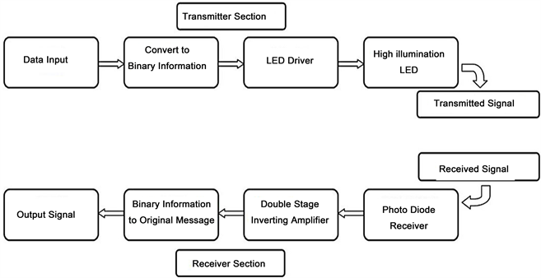
Flowchart:

Slide 10
Arduino Uno and Li-Fi Shield
Li-Fi Shield for Arduino Uno
The Li-Fi shield for Arduino Uno is a high-performance optical communication module that enables data transmission through light waves. It is designed to work with the Arduino Uno board and can be easily attached to it. The shield uses a high-speed photodiode and a LED driver to enable fast and reliable communication between two Arduino boards.
Text Communication Using Li-Fi
The Li-Fi shield can be used to establish text communication between two Arduino boards. To enable this, one Arduino board is configured as a transmitter and the other as a receiver. The transmitter converts the text message into a binary format and encodes it using on-off keying modulation. The encoded signal is then transmitted through the LED on the Li-Fi shield.

Slide 11
The receiver detects the signal using the photodiode on the Li-Fi shield and decodes it to obtain the original text message.
Features of Li-Fi Shield
Supports data rates up to 1 Mbps.
Works in the visible light spectrum (400-800 THz).
Can transmit data up to a distance of 3 meters.
Limitations of Li-Fi Communication
Li-Fi communication has a few limitations that need to be considered. The first is that it works only in the line-of-sight configuration, which means that the transmitter and receiver must have a clear line of sight between them. The second is that it is affected by ambient light, which can interfere with the signal. Finally, it has a limited range of up to 3 meters, which restricts its use to small-scale applications.

Slide 12
Testing and Results
Experimental Setup
For testing the Li-Fi text communication between two Arduino boards, we used two Arduino Uno boards and a Li-Fi shield for each board. The Li-Fi shields were connected to the boards using the SPI interface. We used a laptop with the Arduino IDE to upload the code to the boards and monitor the serial output.

Slide 13
Conclusion and Future Scope
Conclusion
In conclusion, our experiment showed that Li-Fi can be used for text communication between two Arduino boards. We were able to successfully transmit and receive messages using Li-Fi technology.

Slide 14


